Slide 1
Machine Learning in the Milieu
Predicting Genre from Text

Slide 2

Alexander White
Using NLP to aid in Publishing
Natural Language Processing (NLP) is a branch of Machine Learning focused on deriving intelligent insights from computer reading of texts.
This study was an effort to develop a model which would correctly predict the most appropriate genre for a book from the contents of its summary.
Deloitte AI Academy Capstone
January, 2023

Slide 3
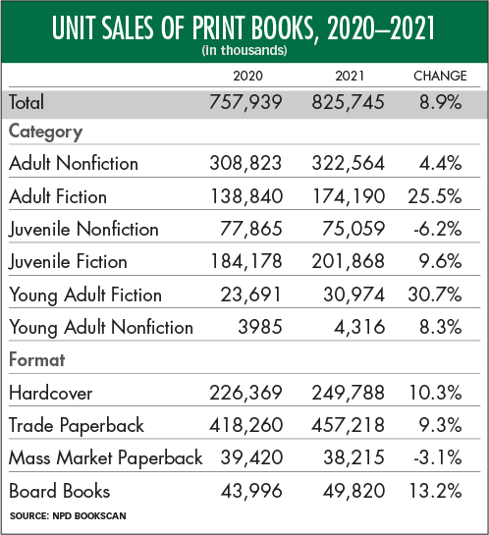
Why use NLP to predict genre?
Genre is one of the main ways people find new books.
Books that are labeled with appropriate genres are likely to find more success with their target audience.
While everyone “knows” what genre is, it can be difficult to define the genre of a text.
Table from Publisher's Weekly, "Print Books Had a Huge Sales Year in 2021" by Jim Milliot, 2022

Slide 4
Our goal is to help publishers and editors like you to quickly and efficiently process the many books you receive.

Slide 5
Developing the model
Our initial hypothesis was that each genre would have its own subset of commonly used words.
We ingested 12,000+ book summaries from a Kaggle dataset, originally sourced from Wikipedia and Freebase.
The summaries were broken into standardized words (for example: am, are, were → is), which were counted and analyzed for each book.
From these counts, we trained our model to predict the associated genre of a book.

Slide 6
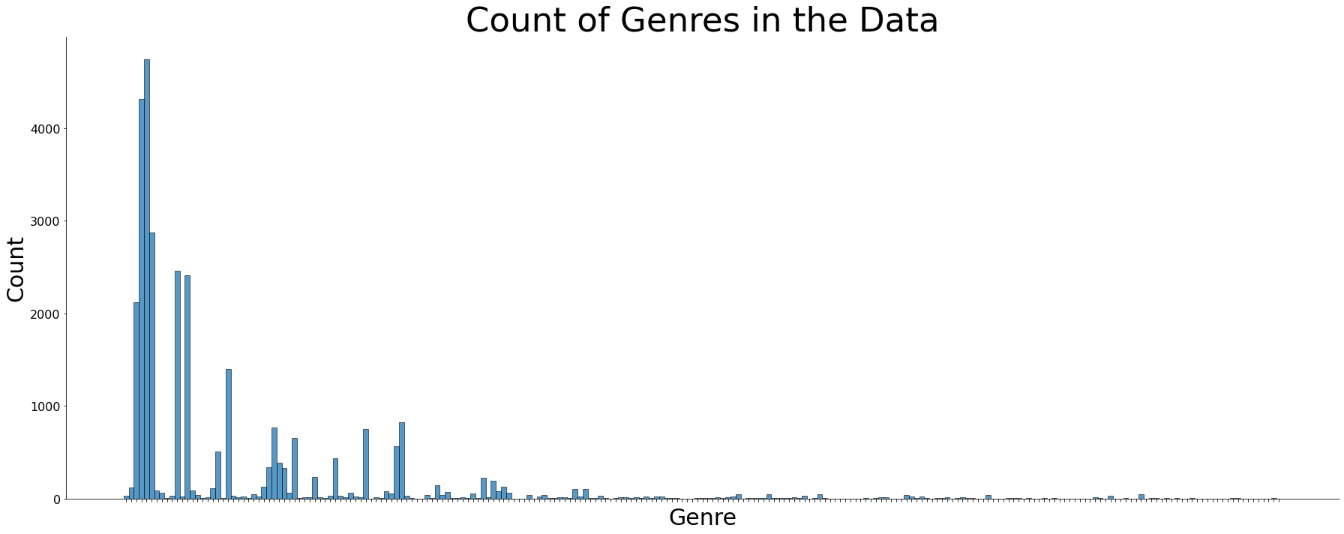
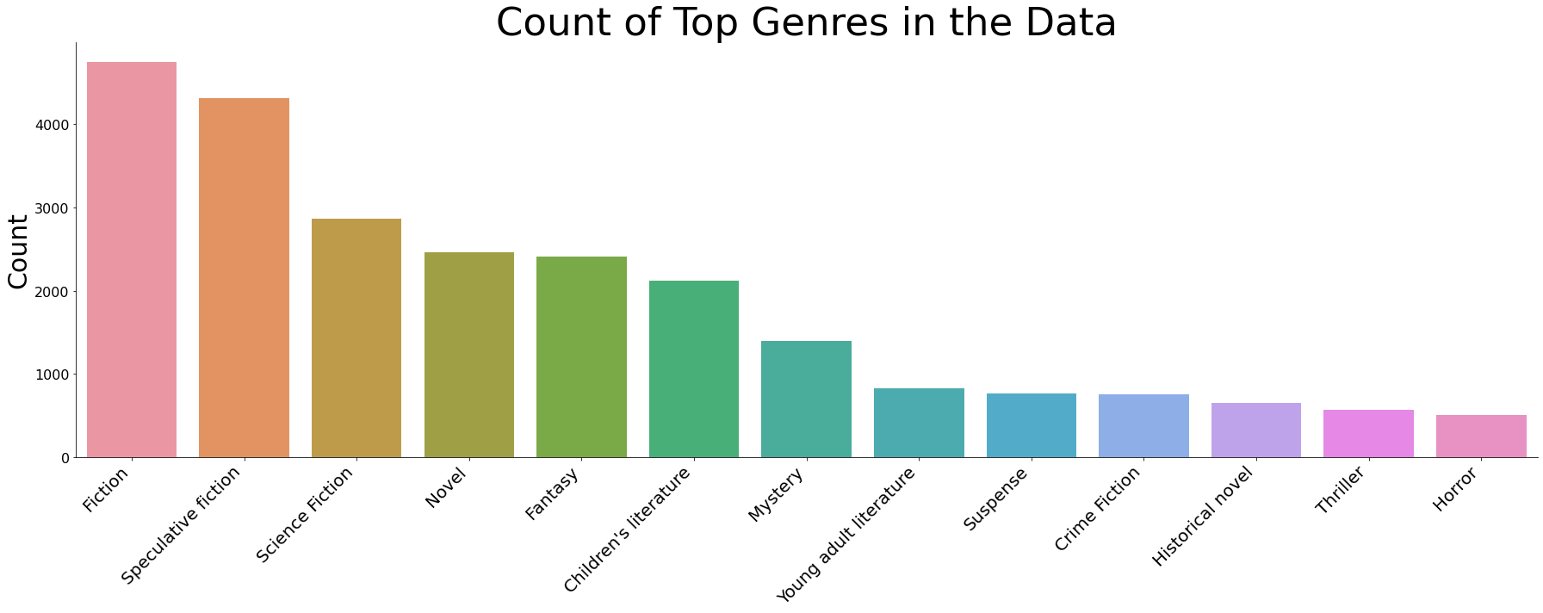
Defining the Data Setting
The initial data was severely unbalanced, so we focused the modeling on only those genres with more than 500 samples in our set.
Initial
Genre | Count
Fiction | 4747
Speculative fiction | 4314
Science Fiction | 2870
Novel | 2463
Fantasy | 2413
…
Pastiche | 1
Marketing | 1
Anti-nuclear | 1
Fictional crossover | 1
Collage | 1
Selected

Slide 7
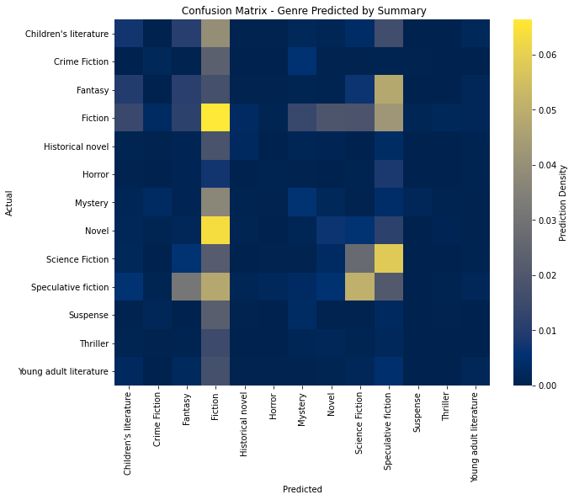
Initial modeling and predictions
genre | precision | recall | f1-score | support
Children's literature | 0.15 | 0.09 | 0.11 | 619
Crime Fiction | 0.15 | 0.06 | 0.08 | 241
Fantasy | 0.14 | 0.11 | 0.13 | 713
Fiction | 0.17 | 0.33 | 0.22 | 1454
Historical novel | 0.26 | 0.09 | 0.13 | 219
Horror | 0.1 | 0.03 | 0.04 | 147
Mystery | 0.15 | 0.1 | 0.12 | 431
Novel | 0.16 | 0.07 | 0.1 | 705
Science Fiction | 0.23 | 0.23 | 0.23 | 881
Speculative fiction | 0.09 | 0.12 | 0.1 | 1262
Suspense | 0 | 0 | 0 | 235
Thriller | 0.03 | 0.01 | 0.01 | 173
Young adult literature | 0.16 | 0.05 | 0.08 | 241
accuracy |  |  | 0.15 | 7321
macro avg | 0.14 | 0.1 | 0.1 | 7321
weighted avg | 0.15 | 0.15 | 0.14 | 7321

Slide 8
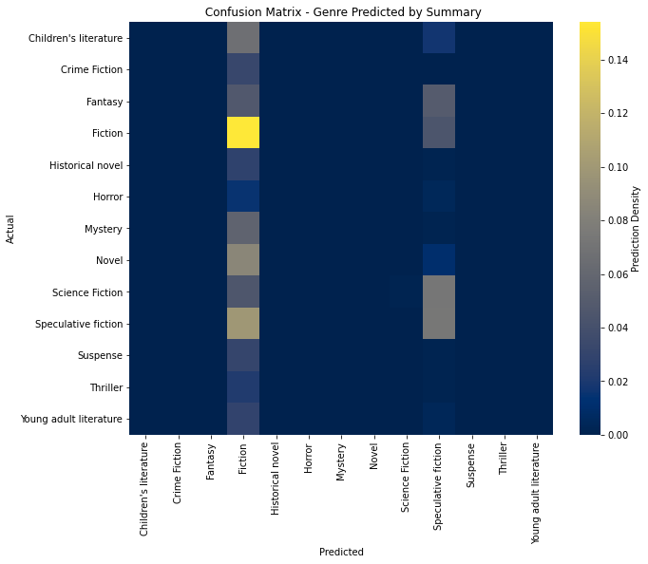
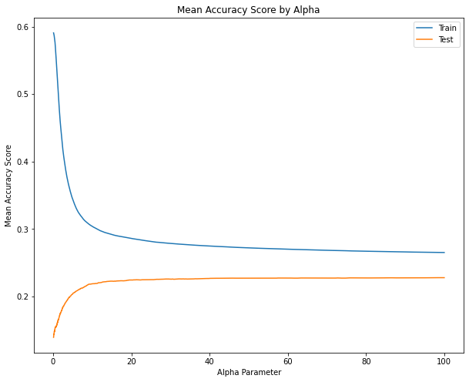
Further training caused loss of precision

Slide 9
Final Model Selection
The initial model performed under our expectations, but did work.
Further training the model increased the accuracy but reduced the utility.
Using our complement naïve Bayes model with Term Frequency – Inverse Document Frequency data, we can predict a book’s genre from its summary about 1 in 5 times.

Slide 10
The Significance: Time is Money
What can this do for you?
What limitations still exist?
Reduce the workload on editors
Provide publishers with rapid suggestions for genre tagging of texts
Help identify “tricky” books
Grow with use
Only considers word use, not order or style
Suggestions are not flawless and accuracy is currently very low
Only works for English language texts
Only suggests a single genre

Slide 11
Next Steps
Given more time, money, and data, we can significantly improve the accuracy and utility of our service.
Examine alternative modeling techniques (such as categorial)
Train with larger datasets
Examine word order and context
Include more genres
Add other features such as sentiment analysis, plot summarization, automatic editorial suggestions, and many more

Slide 12
Conclusions
Publishers and editors can make use of Natural Language Processing to analyze books, even for less concrete ideas such as genre.
This can save man-hours and effort as well as assisting in classifying unusual texts.
The field still has plenty of room for growth and could be extended to many other aspects of the editorial and publishing business.

Slide 13
“[Genre] is what tells you where to look in a bookstore…[it’s] telling you which aisles to not bother going down. That’s the simplicity of book shelving in bookstores. It tells you what not to read.”
-Neil Gaiman, 2013
Thank you for your time.
Are there any questions?

